Slide 1
Analyzing of Active Energy Losses of Power Transformers 110/x kV in the
Kosovo’s Transmission Network
Presented by
Kjani Guri,
KOSTT, Kosovo
17th of May 2019

Slide 2
Paper’s Content
Introduction
Technical losses in Power Transformers
An overview of Kosovo’s Transmission Network
List of Power Transformers 110/x kV categorized by transformation voltage and by ageing
Measured of active energy losses in power transformers 110/x kV through energy meters
Simulation of active energy losses in power transformers 110/x kV by PSS/E
Comparing results of calculating active energy losses in power transformers
Conclusion

Slide 3
Introduction
In this paper is presented the analysis of active energy losses measurement by meter in power transformers 110/x kV in the Kosovo’s transmission network and comparison result with PSS/E.
As we know, main elements of the power systems(after generators) are power transformers, which have a key role in the operation of the transmission and distribution network.
It is absolutely evident that the active energy losses in all power transformers 110/x kV represents a significant value in the overall losses of the transmission network.
In that case, when the number of 110/x kV power transformers is relatively large, the energy losses caused by their operation in power system are evident and have a direct impact in power system losses.

Slide 4
Technical losses in Power Transformers
Like any electrical machine, also in power transformers are caused losses,
Technical losses in power transformers are a consequence of the electromagnetic processes that occur during the transformation process of voltage from high voltage to the medium voltage.
These losses depend on the power transformer’s electromagnetic characteristics as well as by their working regime.
The technical losses in power transformers are divided according to the cause of their appearance as:
      No load losses, and
      On load losses
As we know, No load losses are constant, while on load losses are in function of load.

Slide 5
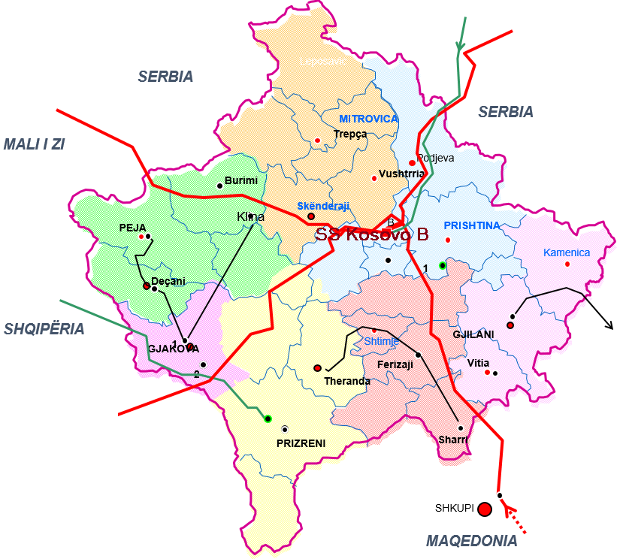
An overview of Kosovo’s Transmission Network
Kosovo’s Transmission Network operating with high voltage transmission lines 400kV, 220kV and 110kV
Voltage (kV) | Length (km)
400kV | 279.5
220kV | 231.8
110kV | 841.8
Amount | 1,353.1

Slide 6
An overview of Kosovo’s Transmission Network
Except transmission lines, part of Transmission Network are substations, including power transformers 400/220kV, 400/110kV, 220/110kV and 110/x kV too.
Transformation (kV/kV) | No. of Substations | No. of Power Transformers | Power Capacity (MVA)
400/220kV | 1 | 3 | 1,200
400/110kV | 2 | 4 | 1,200
220/110kV | 3 | 9 | 1,350
110/35/10kV | 5 | 5 | 220
110/35kV | 6 | 18 | 610
110/10kV | 14 | 30 | 1,042
Amount | 31 | 69 | 5,622

Slide 7
List of Power Transformers 110/x kV
List of Power Transformers 110/x kV categorized by transformation voltage are as below table:
List of Power Transformers 110/x kV categorized by ageing are as below table:
Power Transformers | No. of Power Transformer | Participation in %
110/35/10kV | 5 | 9%
110/35kV | 18 | 34%
110/10kV | 30 | 57%
Amount | 53 | 100%
Age (years) | 110/35/10kV | 110/35kV | 110/10kV | by Age
00 – 15y | 5 | 1 | 14 | 20 | 38%
15 – 30y | 0 | 8 | 2 | 10 | 19%
30 – 40y | 0 | 9 | 9 | 18 | 34%
40 – 50y | 0 | 0 | 3 | 3 | 5%
> 50y | 0 | 1 | 1 | 2 | 4%
Amount | 5 | 19 | 29 | 53 | 100%

Slide 8
Metering System installed in Kosovo’s Transmission Network (1/3)
All metering devices(CTs, VTs and energy meters) are done in accordance with Metering Code and are in accordance with IEC relevant standards for accuracy:
    Current Transformers (CTs) are in accordance with IEC Standards (IEC 60044-1:2003), accuracy class 0.2S, security factor FS=10 and burden of dedicated cores for metering are 15VA (for 110kV), 5-10VA (for 10kV and 35kV);
    Voltage Transformers (VTs) are in accordance with IEC Standards (IEC 60044-2:2003), accuracy class 0.2S, and burden of dedicated windings for metering are 30VA (for 110kV), 5-10VA (for 10kV and 35kV);
    Energy Meters are product of Landis+Gyr/Switzerland, High Precise Meter, Type ZMQ202, with two load profiles, first profile is every 15min and second profile is every 1min. Accuracy class of the energy meters is according with IEC Standards (IEC 2053-22 and IEC 61268). Accuracy class for active energy is 0.2S, while 0.5 is for reactive energy.

Slide 9
Metering System installed in Kosovo’s Transmission Network (2/3)
Design of the existing metering systems installed for each kind of power transformers 110/x kV is shown as below

Slide 10
Metering System installed in Kosovo’s Transmission Network (3/3)
All configuration types of metering systems at power transformers 110/x kV is shown as below figure

Slide 11
Measured of energy losses in power transformers 110/x kV by energy meters (1/3)
Calculation measured active energy losses (ΔW) in power transformers are done based on measured active energy by energy meters (M1, M2 and M3) at primary, secondary and tertiary side of power transformers
  at Type 1 of power transformers(110/35/10kV), active energy losses are calculated as difference between M1 and Σ(M2+M3):
  ΔW = M1 – (M2+M3)
  at Type 2 and Type 3 of power transformers(110/35kV and 110/10kV), active energy losses are calculated as difference between M1 and M2:
  ΔW = M1 – M2

Slide 12
Measured of energy losses in power transformers 110/x kV by energy meters (2/3)
Measured of active energy losses by type of power transformers 110/x kV (during 2018y)
Power Transformers | No. of TR | Measured energy flow at primary side (110kV) | Measured energy flow at secondary & tertiary side (35kV & 10kV) | Energy Losses in TR | %
 |  | MWh | MWh | MWh
110/35/10kV | 5 | 620,873 | 618,721 | 2,152 | 11.31%
110/35kV | 18 | 1,528,134 | 1,521,243 | 6,891 | 36.22%
110/10kV | 30 | 2,114,262 | 2,104,278 | 9,984 | 52.47%
Amount | 53 | 4,263,269 | 4,244,242 | 19,027 | 0.45%

Slide 13
Measured of energy losses in power transformers 110/x kV by energy meters (3/3)
Measured of active energy losses in Power transformers 110/x kV by Age (during 2018y)
Age of Power Transformers (by years) | No. of TR | Measured energy at primary side (110kV) | Measured energy at secondary & tertiary side (35kV & 10kV) | Energy Losses in TR | %
 |  | MWh | MWh | MWh
 |  | A | b | c = a – b | d = c/a
00 – 15y | 20 | 1,892,513 | 1,884,421 | 8,092 | 0.43%
15 – 30y | 10 | 654,727 | 651,943 | 2,784 | 0.43%
30 – 40y | 18 | 1,365,942 | 1,359,593 | 6,349 | 0.46%
40 – 50y | 3 | 193,319 | 192,330 | 989 | 0.51%
> 50y | 2 | 156,768 | 155,955 | 813 | 0.52%
Amount | 53 | 4,263,269 | 4,244,242 | 19,027 | 0.45%

Slide 14
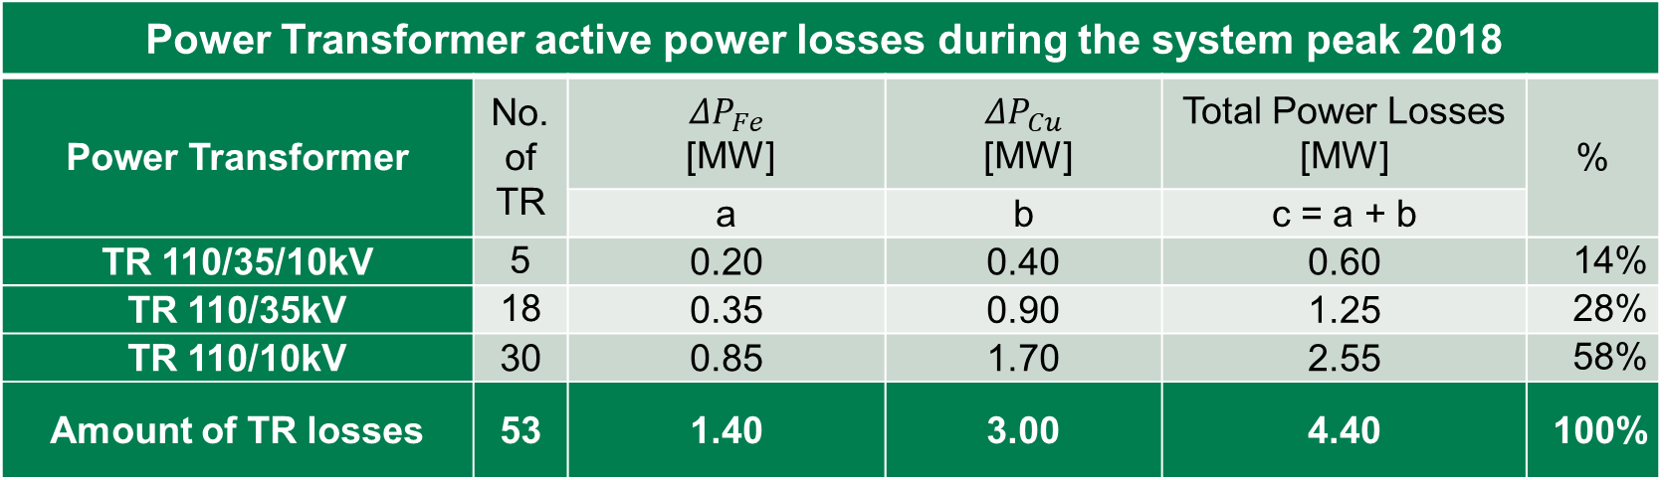
Measured of active energy losses in power transformers 110/x kV by PSS/E simulations (1/2)
The PSS/E simulation is performed for the system conditions as per year 2018, with 1200MW system peak. Simulations results by PSS/E software [6] are presented in below table.
Power Transformer active power losses during the system peak 2018
Power Transformer | No. of TR | ${ΔP}_{Fe}$ [MW] | $ΔP_{Cu}$ [MW] | Total Power Losses [MW] | %
 |  | a | b | c = a + b
TR 110/35/10kV | 5 | 0.20 | 0.40 | 0.60 | 14%
TR 110/35kV | 18 | 0.35 | 0.90 | 1.25 | 28%
TR 110/10kV | 30 | 0.85 | 1.70 | 2.55 | 58%
Amount of TR losses | 53 | 1.40 | 3.00 | 4.40 | 100%
As is shown in the above Table, 58% of total transformer losses is caused by the 110/10 kV power transformers, 28% at the 110/35 kV transformers and 14% at the three winding transformers 110/35/10 kV. From total transformer peak losses around 68% is caused by the load losses and 32% is caused by the no load losses.

Slide 15



Measured of active energy losses in power transformers 110/x kV by PSS/E simulations (2/2)
Considering that no load active losses are constant, the total active energy losses caused by the no-load losses in the all power transformers close to distribution network can be calculated as follows:
$$∆W_{Fe}=∆P_{Fe }∙T_{year}=1.40MW∙8760h=12264 MWh$$
The on load active energy losses are calculated based on system load duration characteristic which determines that total hours of the system losses for the year 2018 in Kosovo’s Transmission Network are around $T_{∆}=2455 hours$.
Calculated transformer active energy losses caused by on load losses are as follow:
$$∆W_{cu}=∆P_{cu }∙T_{∆}=3.00MW∙2455h=7365 MWh$$
The total active energy losses caused in the power transformers close to the distribution network based on calculations are:
$$∆W=∆W_{Fe}+∆W_{cu}=19629 MWh$$

Slide 16

Comparing results of calculating active energy losses in power transformers
Comparing the measured energy results by energy meters and calculation results with PSS/E can be noted that the error of calculated active energy losses is:
$$ε=\frac{{∆W}_{meas.}−{∆W}_{calc.}}{{∆W}_{meas.}}=\frac{19027−19629}{19027}∙100\%=−3.16\%$$
NOTE:
For error calculation we have considered the measurements as referent value.
Based on the obtained results from measured energy by energy meters and obtained results from calculation energy losses by PSS/E software we can see a small difference of energy losses calculation.
This difference from approx. 3% is shown because in normal condition during system operation some of the power transformers 110/x kV has been out of operation for any reasons (maintenance, optimisation, project of refurbishment any of substations, etc.).

Slide 17
CONCLUSIONS
In general power transformers are very reliable equipment, with a projected life cycle over 40 years,
Based on the results, we can conclude that the energy losses in power transformers 110/x kV are increasing by ageing,
In this contest, energy losses increasing in power transformers with increasing the load, so energy losses growing up by the ageing of power transformers,
The difference between the energy losses measured by energy meters and simulation by software PSS/E is to small(about 3%),
These analyses are done for 2018 year,
During preparation phase of technical requirements for new power transformers 110/x kV should have in consideration especially requirements for power losses (no load and on load losses in kW), because their impact is very high during the life of power transformer.

Slide 18
Question by Reviewer:
How much is maximal recorded load of power transformers during their exploitation?
Answer:
For exploitation period (2018y), the maximum load recorded was 1200MW.

Slide 19
Hvala na pažnji!

