Slide 1
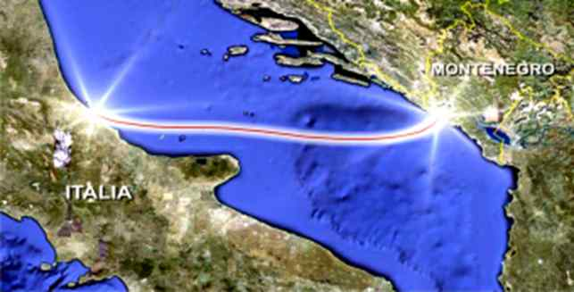
Testing of the HVDC link
Italy – Montenegro
AUTHORS
Gianluca Vettese
Michele Pantini
Nikola Kuljaca
Srdjan Milovic
Marija Mrdak

Slide 2
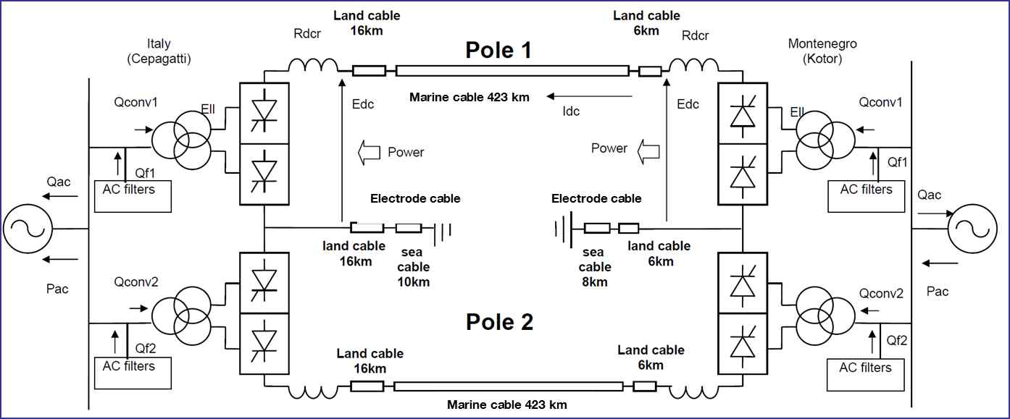


Testing of the HVDC link Italy – Montenegro
Scheme of the link
Stazione 1
Nominal voltage: VDC = 500 kV
Nominal power: PDC = 1000 MW
Configuration: bipolar with marine electrodes
Conversion technology: LCC (line-commuted converter)
Power flow: Bidirectional
Cable type: MI (mass impregnated)
Department for Engineering and Authorization Process

Slide 3
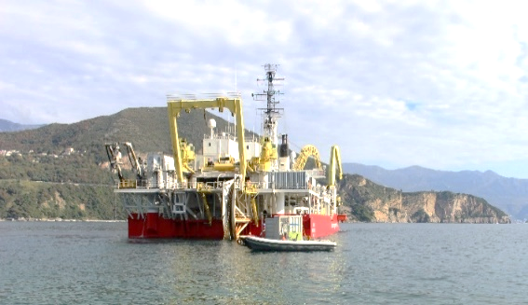
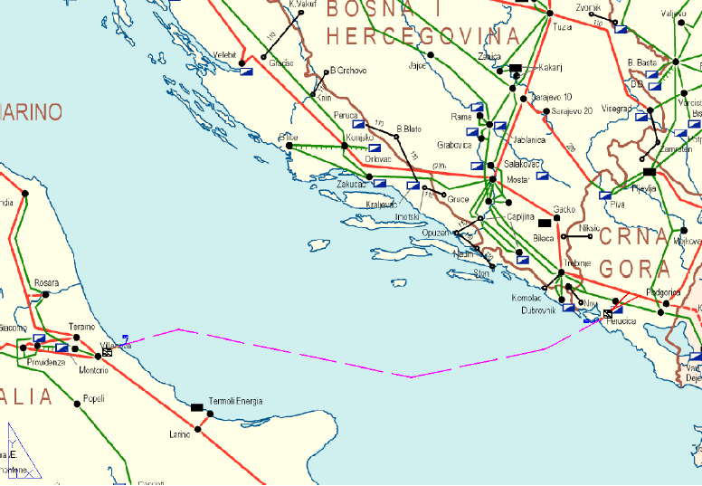
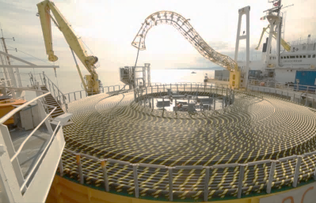
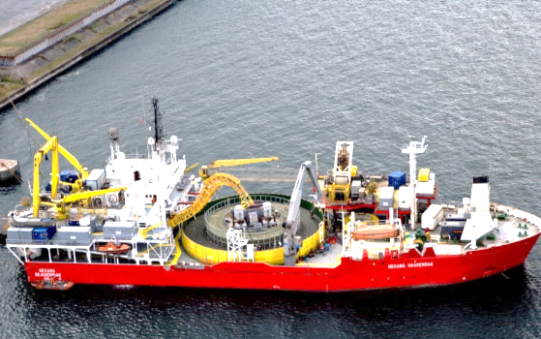
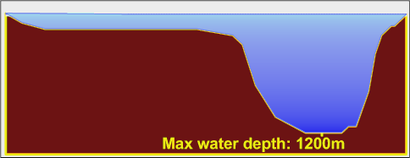
Testing of the HVDC link Italy – Montenegro
Marine cable route and profile
Submarine cable length: ~ 423 km
Bathymetric overview:
Department for Engineering and Authorization Process

Slide 4
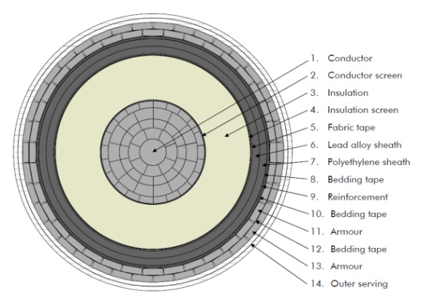
Testing of the HVDC link Italy – Montenegro
Testing of the HVDC cable
500kV DC SUBMARINE CABLE
- Conductor cross section: 1900mm2
- Cable diameter: 130mm
- Cable weight: 44kg/m in air – 31kg/m in water
500kV DC UNDERGROUND CABLE
- Conductor cross section: 1900mm2 (Cu)
- Cable diameter: 120mm
- Cable weight: 42kg/m in air
Submarine cable route: ~ 423km:
~ 25km in Montenegrin territorial waters
~ 77km in Italian territorial waters
Underground cable route: ~ 22km
~ 6km in Montenegro
~ 16km in Italy
Department for Engineering and Authorization Process

Slide 5
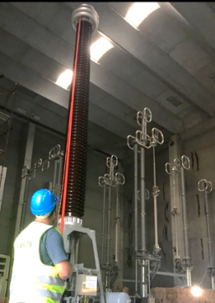
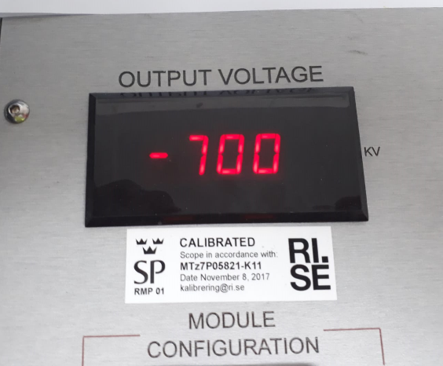
Testing of the HVDC link Italy – Montenegro
Testing of the HVDC cable
HVDC test of the complete cable system test at 700kV DC
  The test has been performed gradually rising the voltage up to 700kV DC. After the period of 15min (as prescribed by the relevant standards [1]) at 700kV and during the next descent of the applied voltage (and discharge phase) no breakdown has been detected which assured that the test has positively passed and that the cable can be safely put in operation.
  [1] CIGRE Recommendation Electra No. 189, “Recommendations for tests of power transmission DC cables for a rated voltage up to 800 kV”
Department for Engineering and Authorization Process

Slide 6
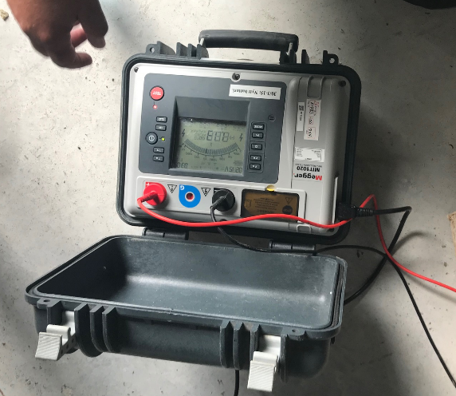
Testing of the HVDC link Italy – Montenegro
Testing of the HVDC cable
(TDR) Time Domain Reflectometry test
  By applying an impulse having some hundreds of volts in peak to the complete HVDC cable system (from Italy side) with an open end at the opposite extremity (Montenegro side) it has been possible to make the impulse travel along the entire cable and reflect back to the voltage source where its reflection signal has then been recorded. The recorded waveform shown no abnormalities along the cable length and also will be stored and used as a basic “fingerprint” for future diagnostic purposes.
  Furthermore, during installation, before final testing, after laying of each section of underground cable, a voltage of 10kV has been applied to the cable outer sheath for 1 minute has been applied in order to evaluate if any damage during cable installation and laying has occurred
Department for Engineering and Authorization Process

Slide 7
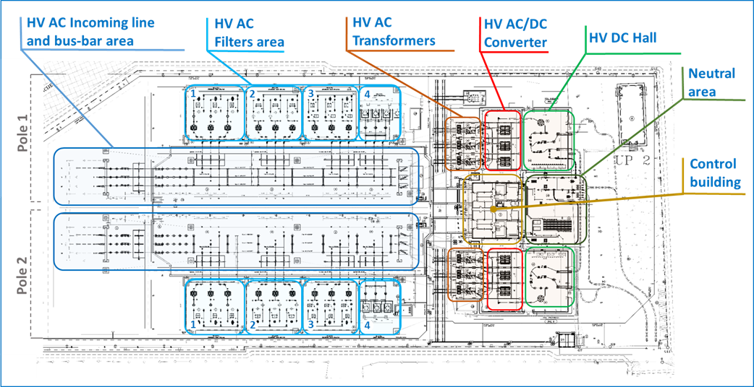
Testing of the HVDC link Italy – Montenegro
Converter station
Department for Engineering and Authorization Process

Slide 8
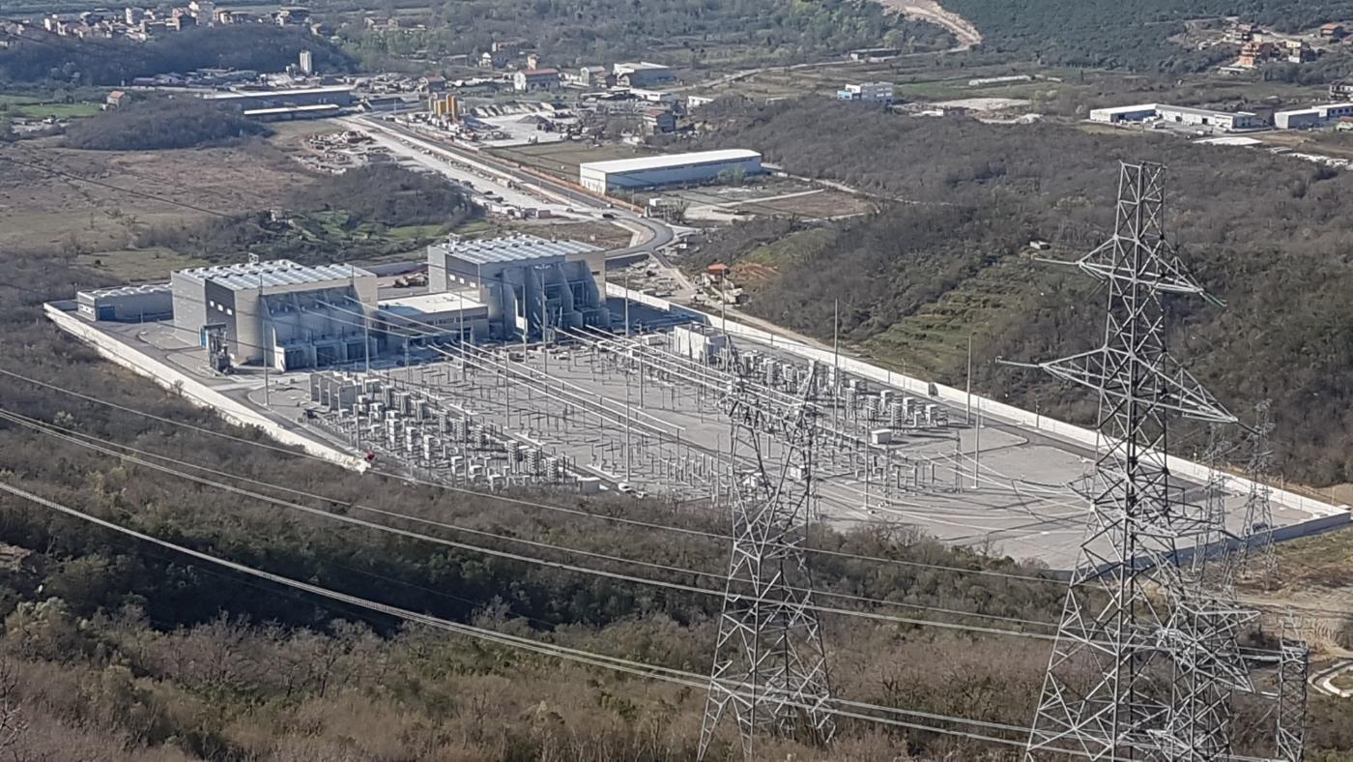
Testing of the HVDC link Italy – Montenegro
Converter station
Valve hall
Control building
DC building
Converter transformers
Filters
Department for Engineering and Authorization Process

Slide 9
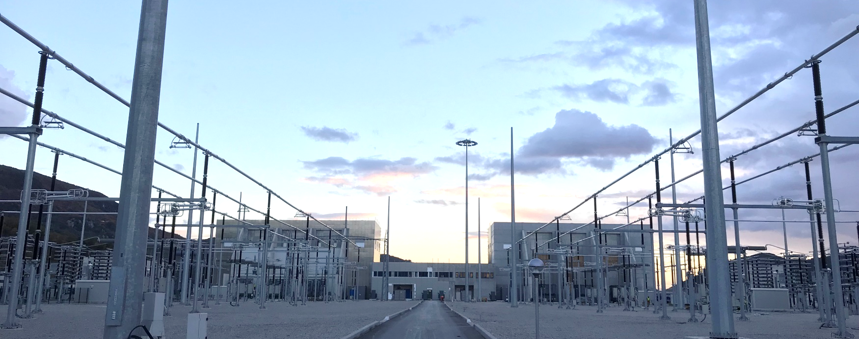
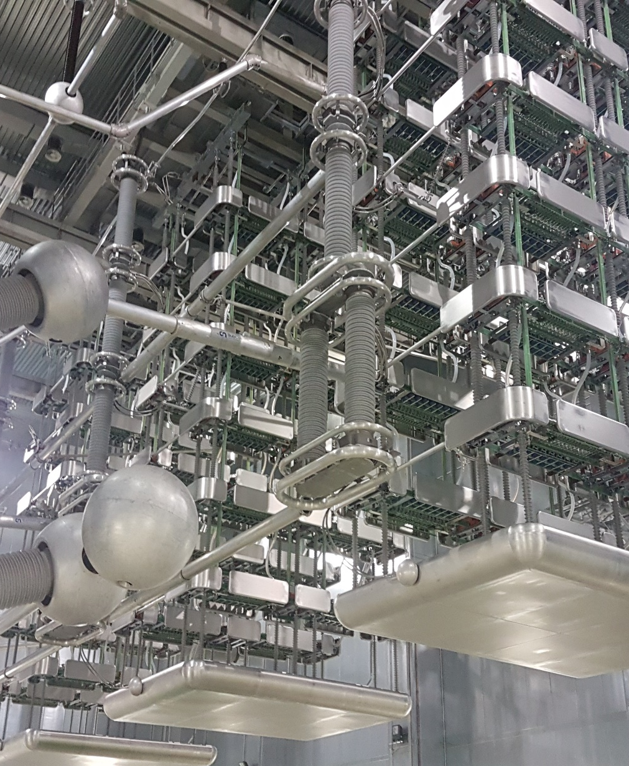
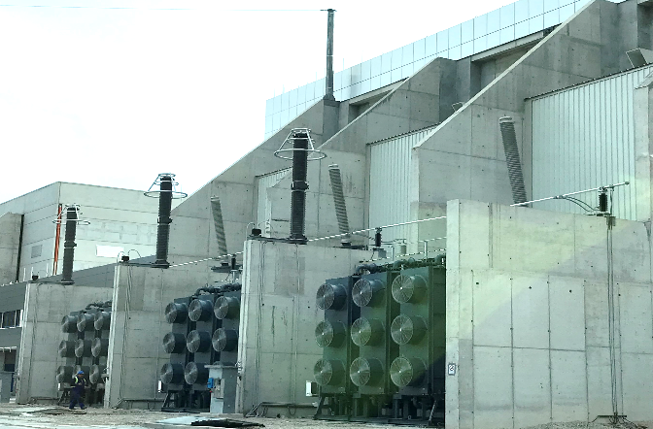
Testing of the HVDC link Italy – Montenegro
Converter station
Department for Engineering and Authorization Process

Slide 10
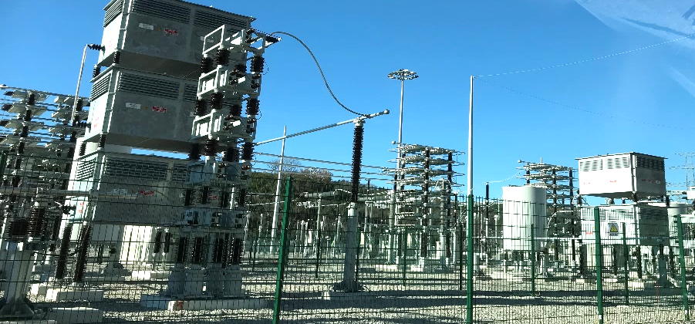
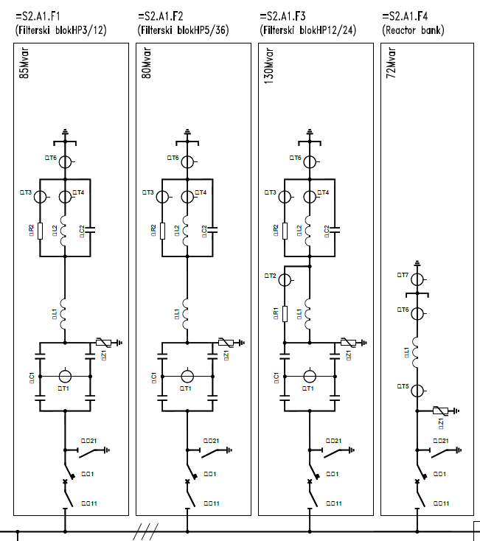
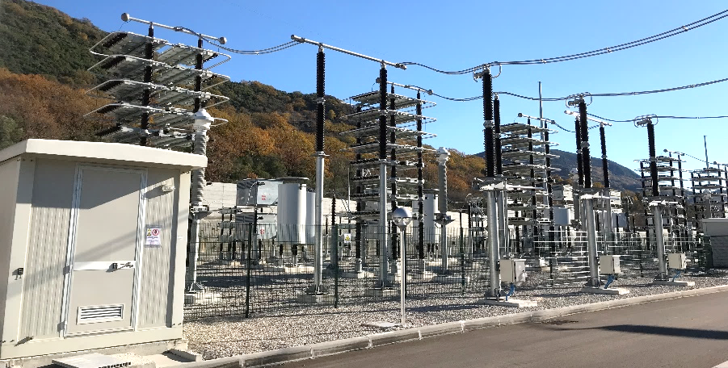
Testing of the HVDC link Italy – Montenegro
Testing in the HVDC station: filters
Department for Engineering and Authorization Process

Slide 11
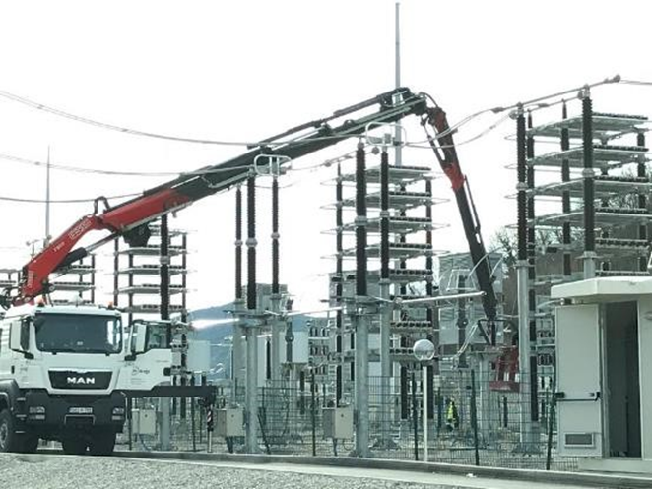
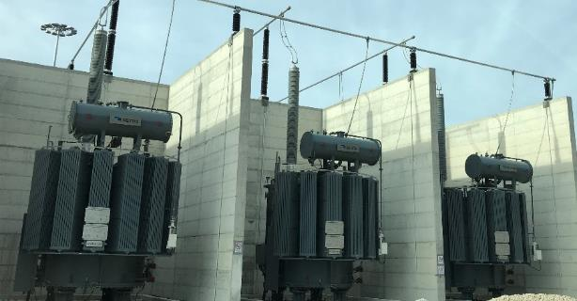
Testing of the HVDC link Italy – Montenegro
Testing in the HVDC station: filters
Capacitors
  Capacitance measurements : Performed on all units in the bank (benefit of having a reference value of capacitance for future maintenance)
  Unbalance current : Purpose is to verify that the capacitor bank has been properly balanced
Resistors
  Measurement of the cold resistance value
Shunt reactors
  Short circuit impedance
  Measurement of turn ratio
  Winding insulation resistance to ground
  Insulation resistance of core, shields and core clamps
  Windings ohm resistance
  Insulation resistance and verification of proper functionig of wiring diagram
  SFRA measurement
  Capacity and Tan Delta
Department for Engineering and Authorization Process

Slide 12
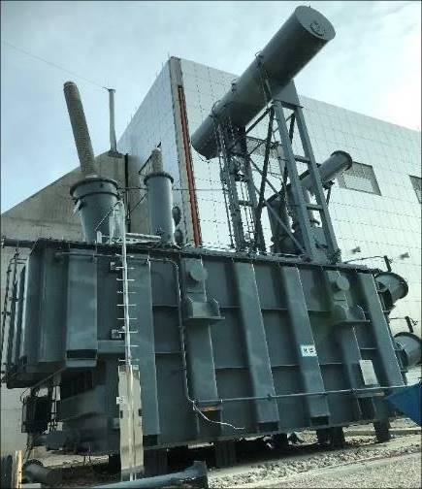
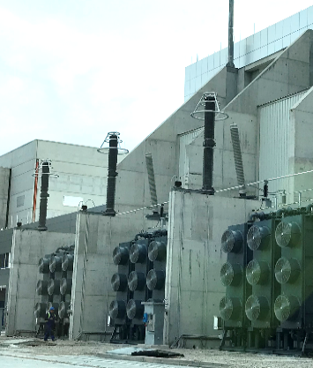
Testing of the HVDC link Italy – Montenegro
Testing in the HVDC station: Converter transformer
Department for Engineering and Authorization Process

Slide 13
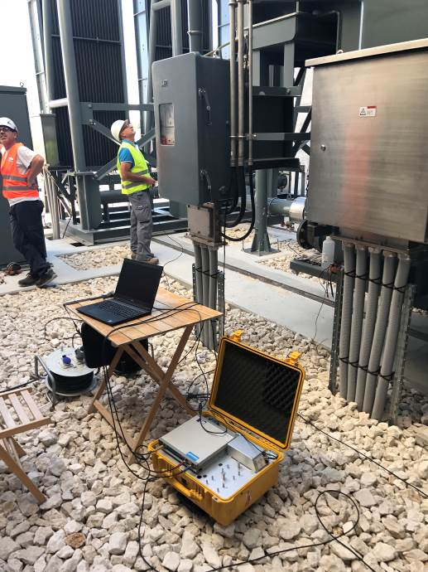
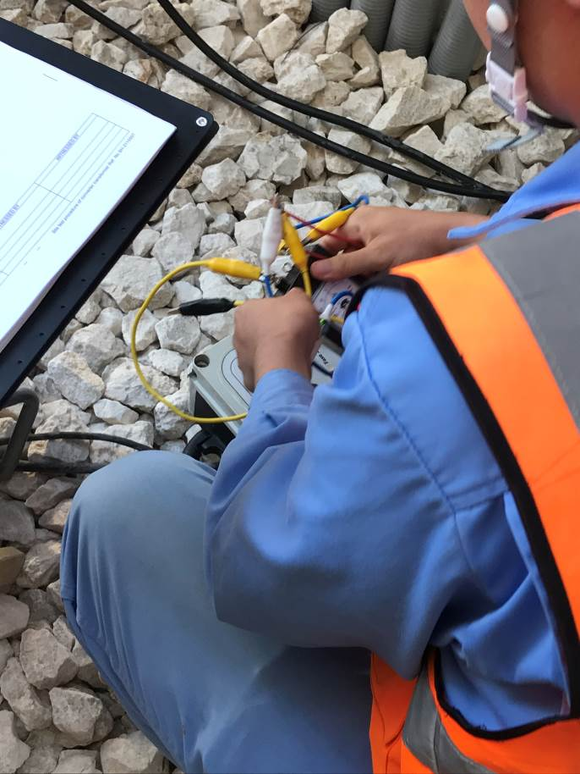
Testing of the HVDC link Italy – Montenegro
Testing in the HVDC station: Converter transformer
Measurement of insulation resistance of core
  Core and armature
  Armature and tank
  Core and tank
Measurement of the frequency response (SFRA)
Check of the internal pressure for:
  The dry air (DA) pressure inside of all the bushings turret
  The gas pressure in related bushings
Internal connection and inspection
  Checking the insulating oil
  Measure insulation resistance between core and clamp
  Measure insulation resistance between clamp and tank
  Visual check of inside tank
Department for Engineering and Authorization Process

Slide 14
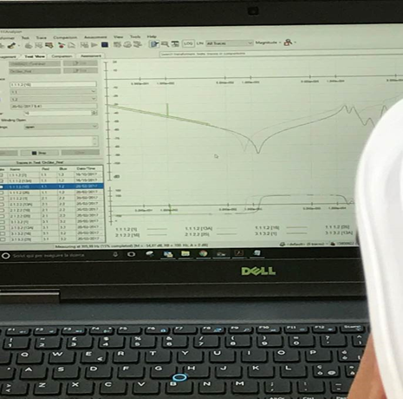
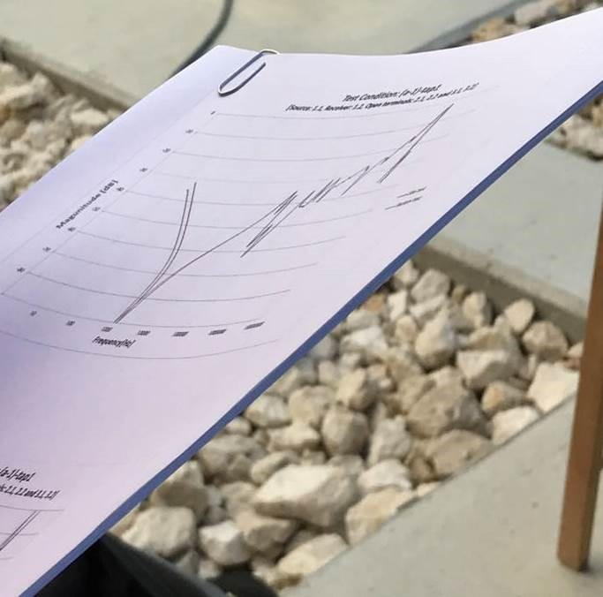
Testing of the HVDC link Italy – Montenegro
Testing in the HVDC station: Converter transformer
Measurement of the d.c. insulation resistance of winding
Insulation resistance (R15, R60, R180 and R600) of each winding is measured with 5kVdc megohm meter. The absorption ratio (R60/R15) and polarization index (R600/R60) are calculated. Results are compared with reference data to see is there any deviations
Measurement of capacitance and dissipation factor (tanδ)
Capacitance and dissipation factor (tanδ) of windings including bushings are measured at 50Hz-10kV with tanδ measuring system
Check of polarity
Polarity of winding is measured by inductive kick method. The polarity of winding should be “subtractive polarity”. (When switch is closed, deflection of DC ammeter should be positive, and when opened, deflection of DC ammeter should be negative.)
Measurement of short circuit impedance under low voltage
The measurement is done in tap position min, max, central and rated. Difference between measured value at site and factory test data should be within ±3%.(Manufacturer standard)
Measurement of the winding resistance
The mesurement is done for each tap of OLTC. The winding resistance is measured by a drop of potential method on all windings at all tap positions. Measured resistance value is converted to 75℃. Difference between measured value at site and factory test data should be within ±5%.(Manufacturer standard).
Measurement of the frequency response (SFRA)
Department for Engineering and Authorization Process

Slide 15
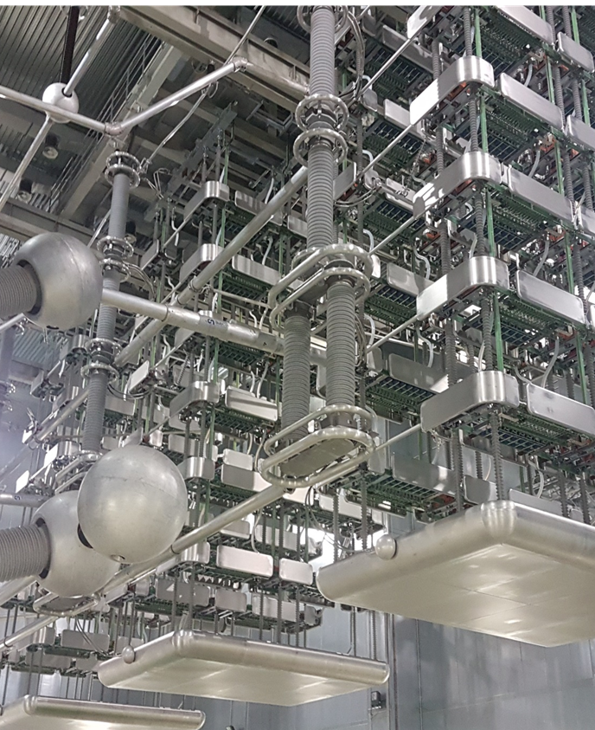
Testing of the HVDC link Italy – Montenegro
Testing in the HVDC station: Converter
12 pulses converter
3 quadruple thyristor valve (q.t.v.) water cooled
300 thyristors per each q.t.v.
900 thyristors in total
Department for Engineering and Authorization Process

Slide 16
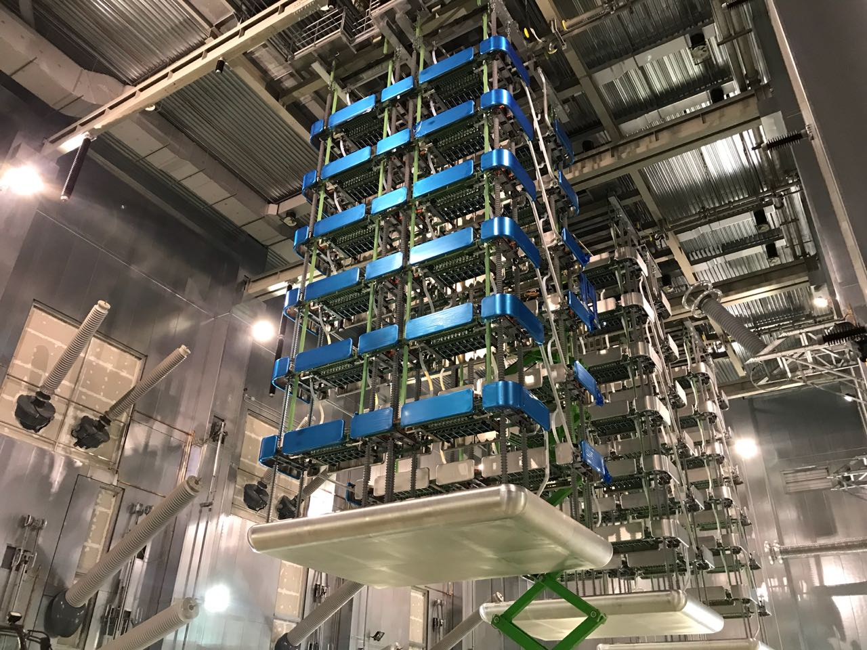
Testing of the HVDC link Italy – Montenegro
Testing in the HVDC station: Converter
Tests and inspections at the end of the Quadruple Valve installation
  Quadruple Valve visual inspection
  Confirmation with the size
  Measuring the distance
  Checking of cooling system
  Voltage grading circuit check among series connected modules in one valve
  Voltage grading circuit check among series connected thyristors in one module
Tests and inspections at the end of assembly Valve Base Electronic (VBE)
  VBE visual inspection
  Check the external metal cables and optical fiber cable connection
  Measurement of insulation resistance
  Measurement of control power supply
  Confirmation of input/output signal
  Gate pulse check
Combination test of Quadruple Valve and VBE
  FV (Forward Voltage) and RV (Reverse Voltage) signal check
  Checking of LD power (LASER Diode optical power)
  Firing check (Thyristor turn- on check)
Department for Engineering and Authorization Process

Slide 17
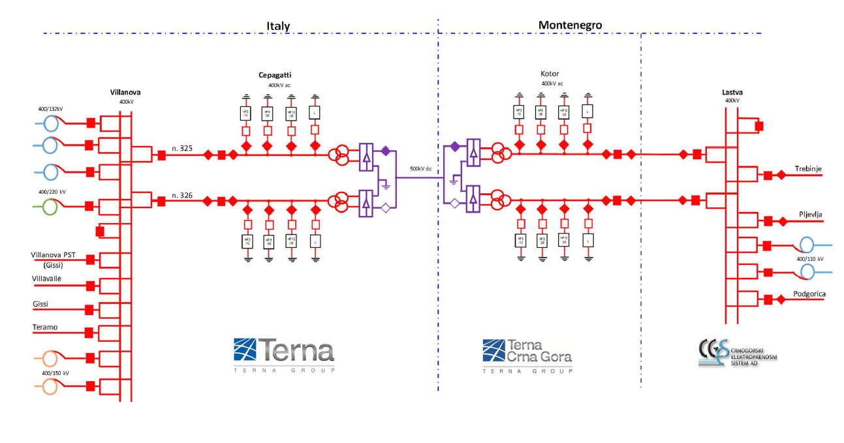
Testing of the HVDC link Italy – Montenegro
Commissioning Tests – general scheme
The commissioning tests on HVDC directly involve both Montenegrin and Italian systems.
For this reason, it was put into place a strong coordination between CGES and Terna on safety and execution of tests, consisting of safety meeting, common procedures and specific agreements.
Department for Engineering and Authorization Process

Slide 18
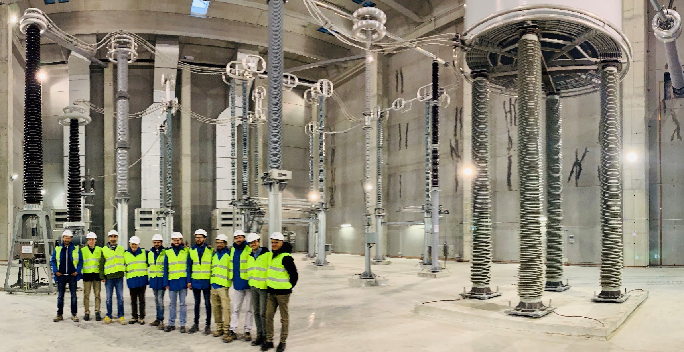
Testing of the HVDC link Italy – Montenegro
Commissioning Tests – general plan
First phase : Energization of the plant, starting from AC part (transformers and filters) up to the converter
Second phase: Energization of the converter, the DC equipment and the HVDC cable concluding the open line test (OLT)
Third phase: Consists in the low power transmission tests
Fourth phase: The interconnection has to be tested up to full power in order to verify the performances of all the components and sub-systems
Department for Engineering and Authorization Process

Slide 19
THANK YOU FOR YOUR ATTENTION

